Slide 1
Genetic Engineering Self-Paced Activity
Monday March 16, 2020

Slide 2
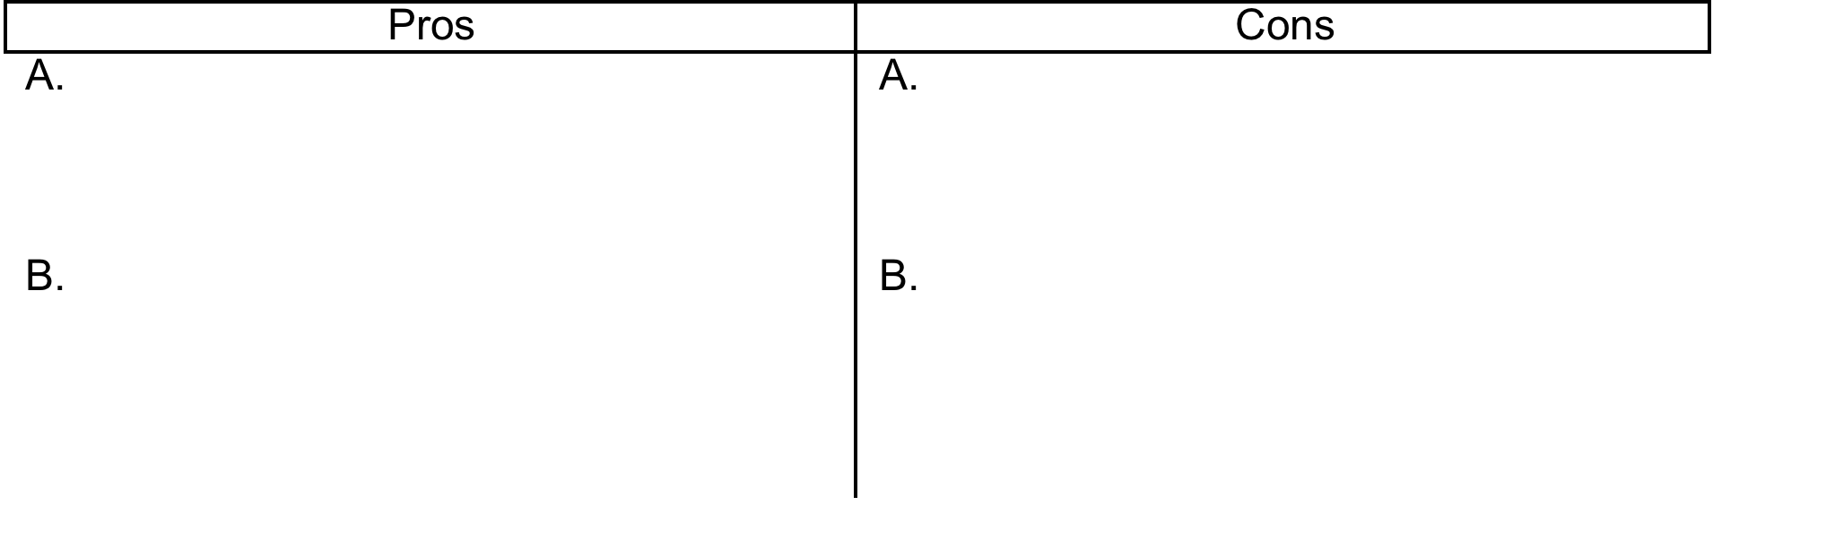
Introduction to Genetic Engineering from Scientific American
https://www.scientificamerican.com/video/what-is-a-genetically-modified-food2013-07-24/
Watch the first 20 seconds of the video (whole thing is about 3 minutes). Go to the following link and read the short description about chickens without feathers and list at least two pros and cons about developing chickens without feathers.
http://news.bbc.co.uk/2/hi/science/nature/2000003.stm

Slide 3
Continue watching the video….
2. What is the difference between traditional selective breeding and modern genetically modifying foods?

Slide 4
TED Talk: The Ethical Dilemma of Designer Babies
BEFORE you watch the TED Talk, answer the following question:
1. Given what you’ve learned about genetic engineering so far do you think that scientists should use genetic engineering techniques with humans? Why or why not?

Slide 5
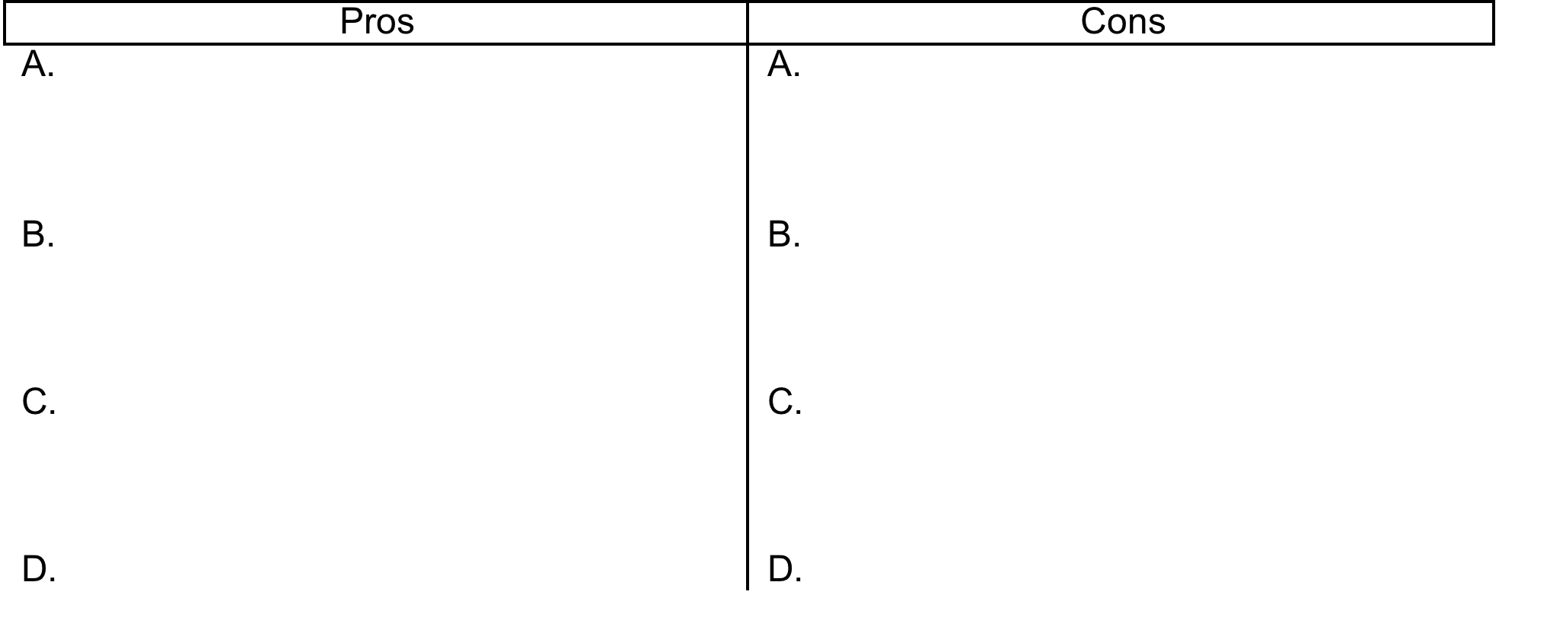
AS you watch the video
https://www.ted.com/talks/paul_knoepfler_the_ethical_dilemma_of_designer_babies
2. Fill out the following table with Pros and Cons. You can stop the video as needed to fill out the table. Try for at least 3-4 of each. Include enough detail that it will make sense to you later.

Slide 6
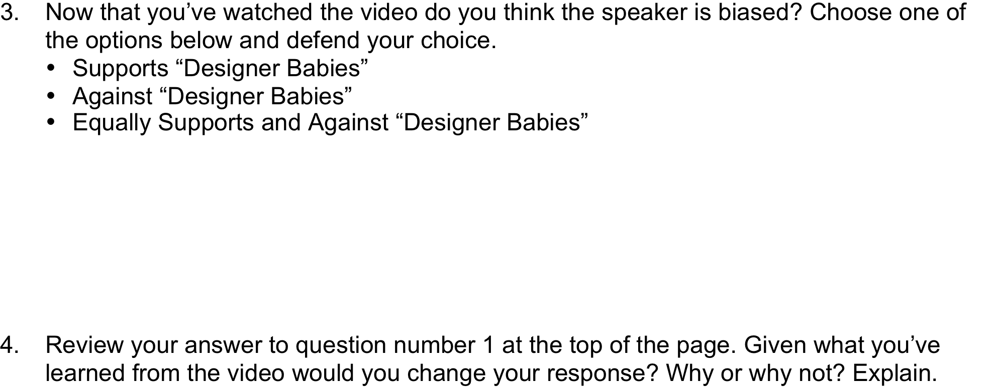
AFTER you watch the video

